Slide 1

ARE GREENHOUSE GASES THE BIGGEST THREAT TO BIODIVERSITY?
By Reshma Zaman

Slide 2
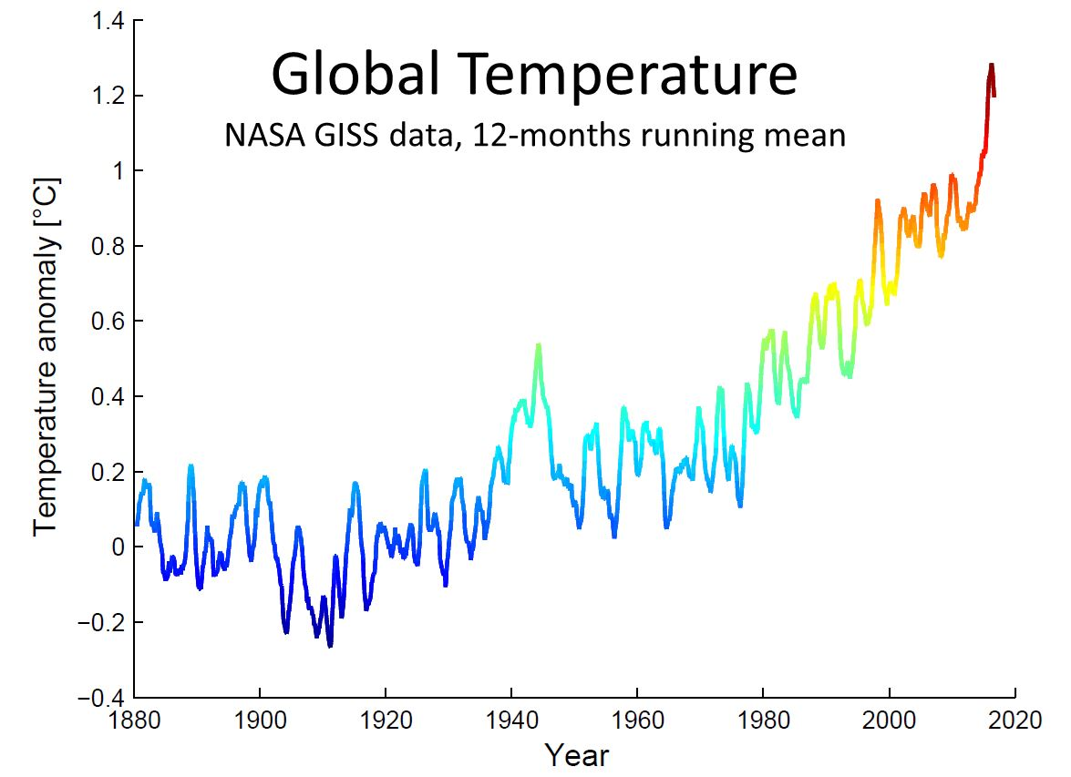
INTRODUCTION
Biodiversity is the variety of all life on Earth - animals, plants, fungi and micro-organisms like bacteria.
The government has attempted to preserve biodiversity, but the issue of greenhouse gases and global warming is rapidly increasing.

Slide 3
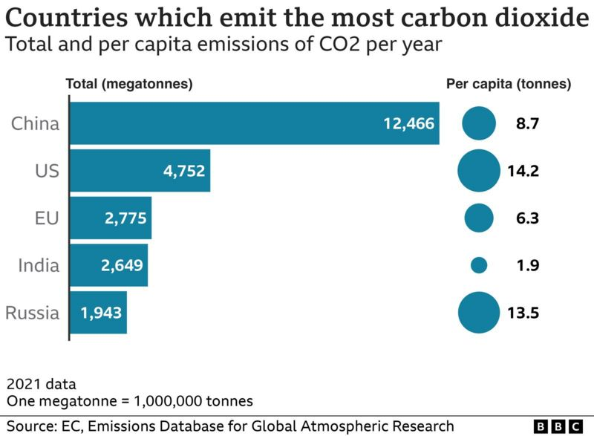
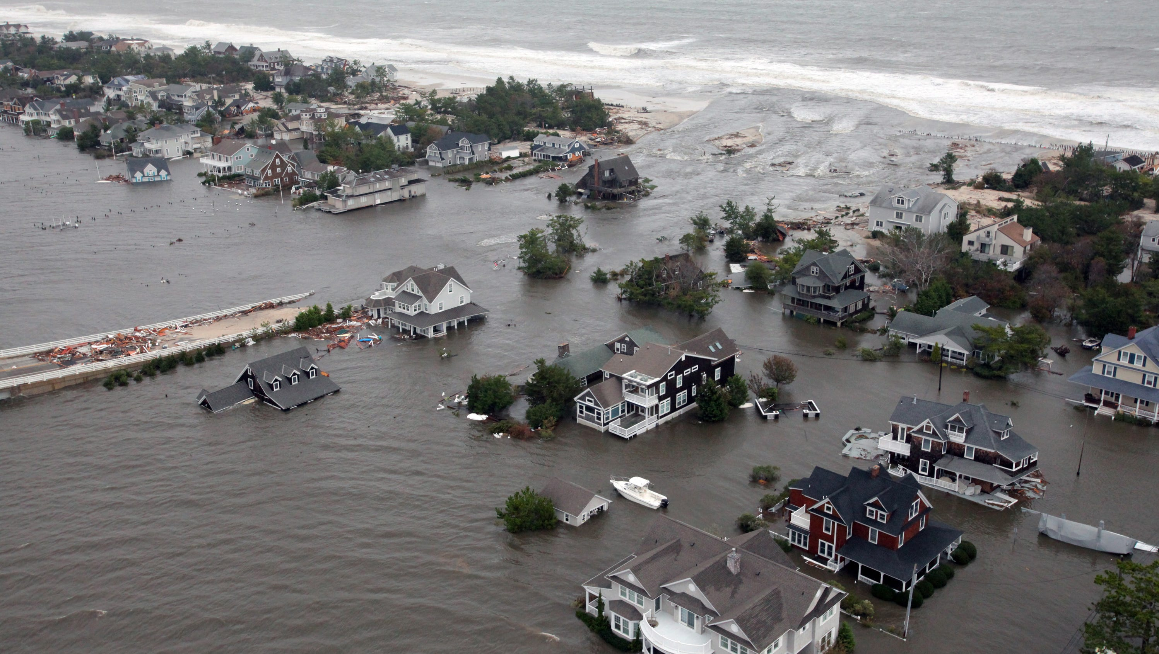
Greenhouse Gases
Greenhouse gases mainly consists of water vapours, Carbon Dioxide, Methane, Nitrous Oxide and Ozone and they maintain the earth's temperature.
CO2 production- respiration and burning of fossil fuel like coal, oil and gas.
GHG emission causes evaporation which causes droughts and rising of sea levels.

Slide 4
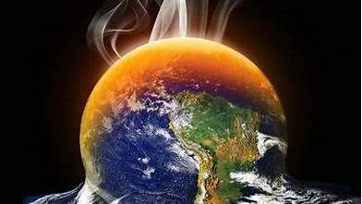
Global warming
Global warming increases the earths global temperature.
Major reason being pollution which is caused by
burning of fossil fuels and deforestation - damages the biodiversity.
Factory carbon emissions/ toxic dumping of waste in the oceans and seas which is a threat to marine life - which in turn leads to less food and economy.
Increasing temperature – north & south pole ice melting constantly endangering species.

Slide 5

conclusion
In conclusion GHG’S are the biggest threat to biodiversity as an increased emissions of greenhouse gases will result in global warming leading to biodiversity destruction.
The biodiversity helps maintain the food chain. Moreover, it protects us from natural disasters.
Solutions :
- Walking or bicycling
- Reducing deforestation
- Using renewable energy

